Slide 1

Research on Research on Research: Analyzing Historical Trends in Statistical and Computational Research from the 1990s to Modern Day
Naren Prakash

Slide 2
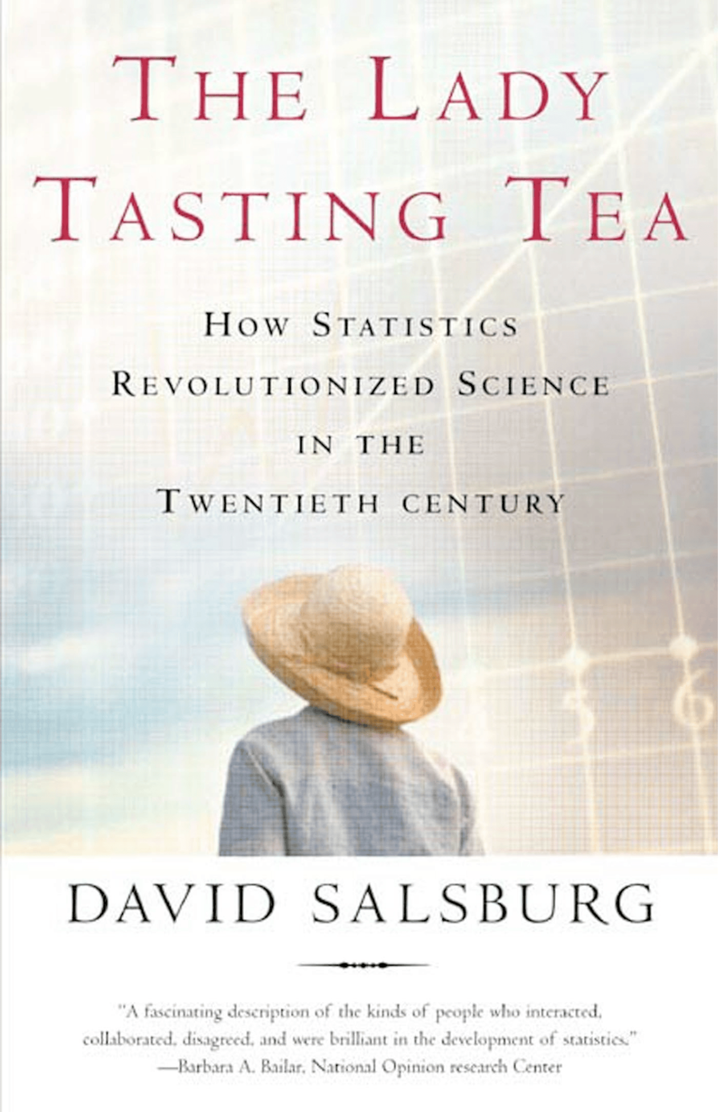
Motivation
How has the current research landscape for statistical and computational fields changed in the past 30 years?
Can we trace the development of ideas in more “recent” fields such as generative AI and reinforcement learning?

Slide 3
Dataset
136,238 observations and 10 columns
Column names: id, title, category, category code, published date, updated date, authors, first author, summary, and summary word count
Originally scraped from arXiv, dataset from Kaggle
For initial analysis: partitioned into two datasets (one statistical, one computational)

Slide 4
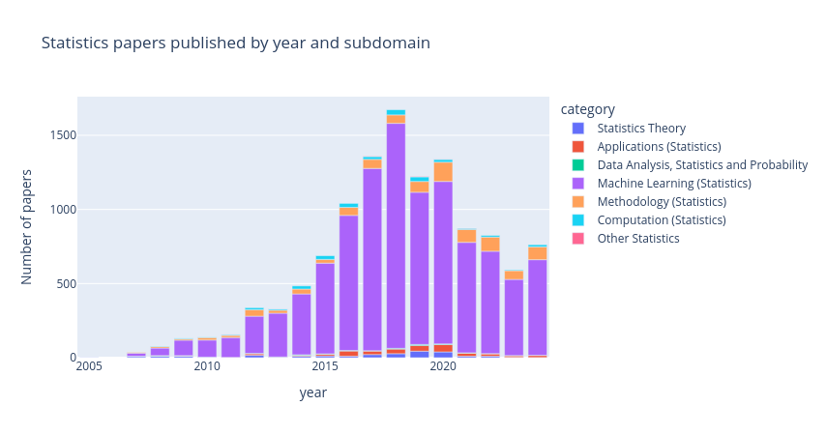
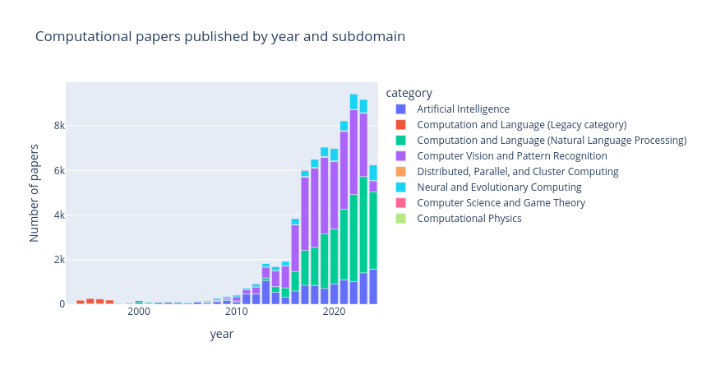
EDA Plots

Slide 5
Initial Results: Statistical
Largest publication increases: Machine Learning, Methodology, Applications
Top 3 fields remained Machine Learning, Methodology, and Application/Computation

Slide 6
Initial Results: Computational
Largest publication increases: Artificial Intelligence, Computer Vision, Neural and Evolutionary Computing
Top 3 fields remained Artificial Intelligence, Computation and Language (NLP), Computer Vision and Pattern Recognition

Slide 7
Predictive Model
Time series model created using a LightGBM regressor
  Monthly data from 1994 to 2024
Aim to predict research output for the first half of 2025

Slide 8
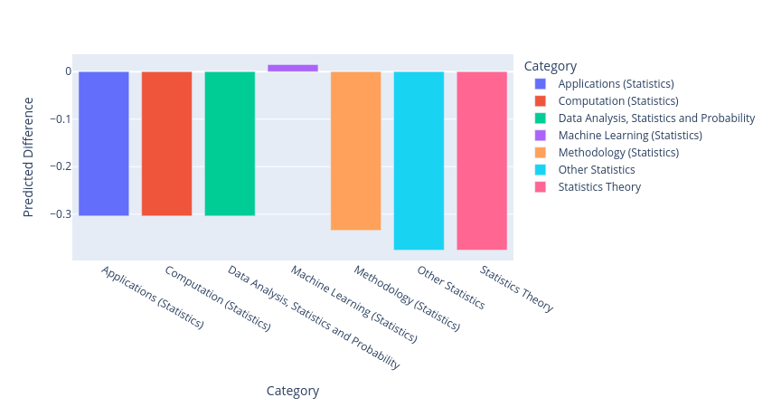
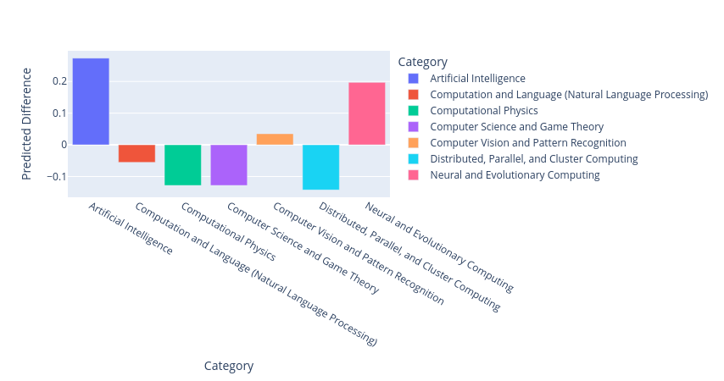
Prediction Results
Statistical
Computational

Slide 9
Digging Deeper: Ideological Progression
How can we analyze by content and not just category?
Want to use text mining techniques such as:
  n-grams
  topic modeling techniques
  clustering

Slide 10
BERTopic: Extraction and Labeling
Used paper abstracts to extract key words and phrases
Why BERTopic?
  Contextual understanding from Large Language Models
  Incorporation of traditional text mining techniques
    TF-IDF, n-grams, etc.

Slide 11
How do we find these labels?
BERTopic Pipeline:
  Dimension reduction
    UMAP (Uniform Manifold Approximation and Projection)
  Clustering
    HDBSCAN
  Topic Modeling
    CountVectorizer, c-TF-IDF, KeyBERT, ChatGPT

Slide 12
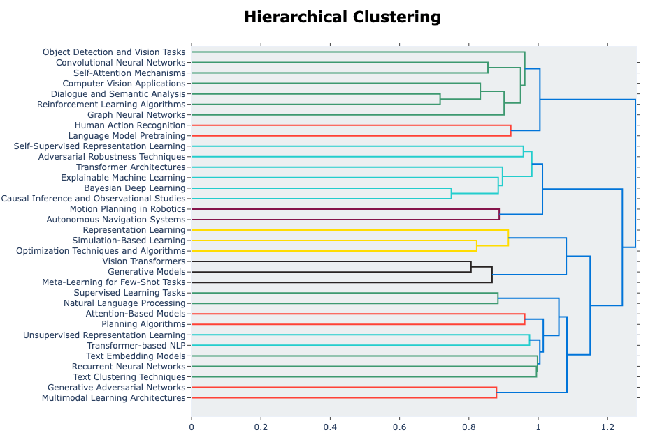
How do we find these labels?

Slide 13
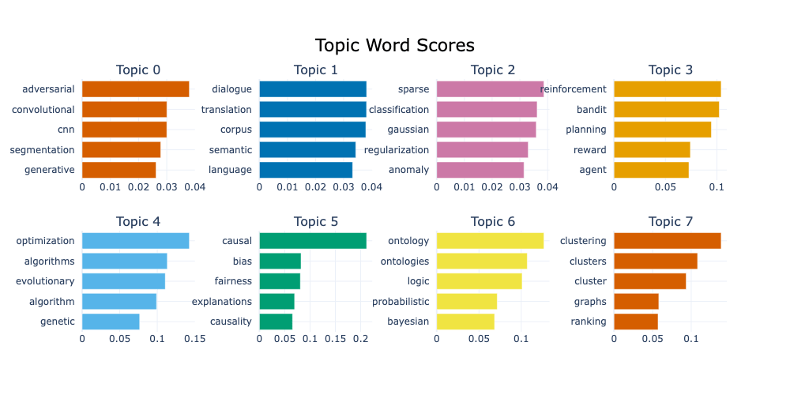
Labels (35 final topics)
0: Adversarial Robustness in Convolutional Networks
1: Dialogue Systems and Machine Translation
2: Sparse Modeling and Gaussian Classification
3: Reinforcement Learning and Bandit Algorithms
4: Optimization Algorithms in Machine Learning
5: Causal Inference and Treatment Effects
6: Bayesian Inference and Probabilistic Models
7: Graph Neural Networks

Slide 14
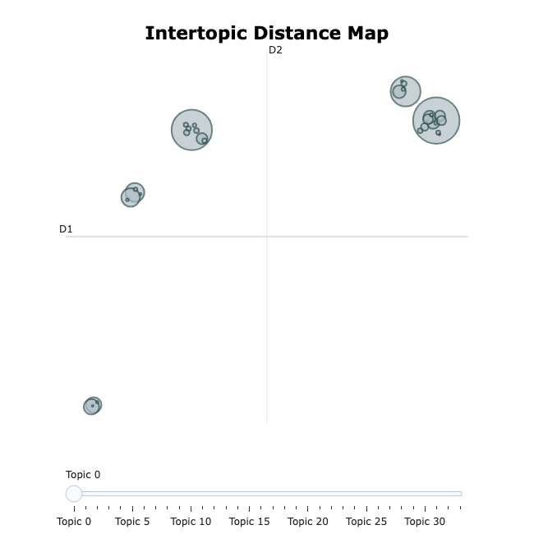
Relationships between Topics

Slide 15
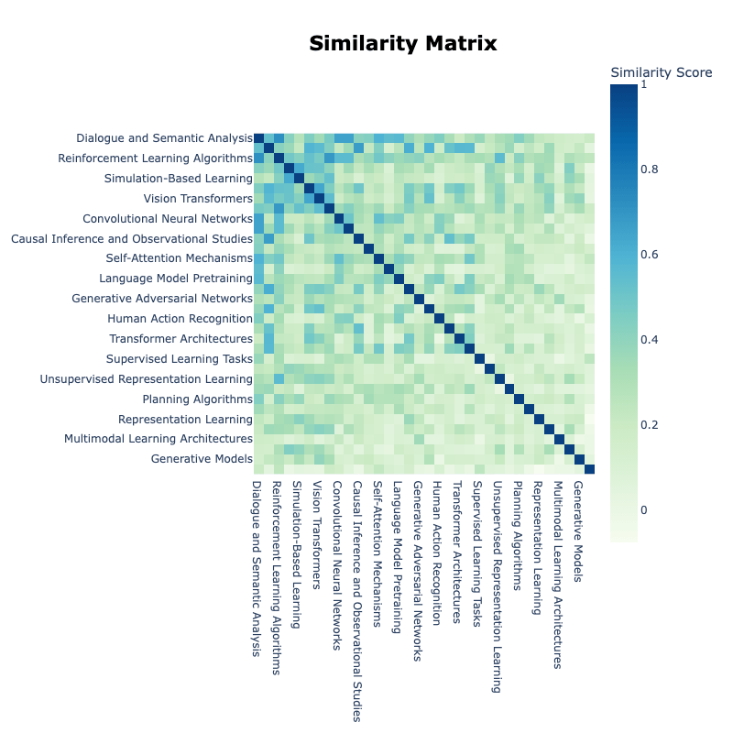
Relationships between Topics

Slide 16
The Big Picture
Search for explainability with AI
  Using LLMs themselves to understand their development
Possibility of reawakening research in “dead ends”
  Possible links to the hottest subfields of today
High level overview of today’s technology to create tomorrow’s

Slide 17
Acknowledgements
A HUGE thank you to Professor Vivian Lew for her encouragement and advice throughout this entire process, I would not have this project here today without her
Would also like to thank all of the professors in the Statistics Department for exposing us to the models and algorithms used in research today

